Slide 1

The Experience of Siblings of Children with Developmental Disabilities
Notes:
----- Meeting Notes (6/16/15 10:25) -----
interest in experience of sibings and how we can meet their needs as clinicians.

Slide 2
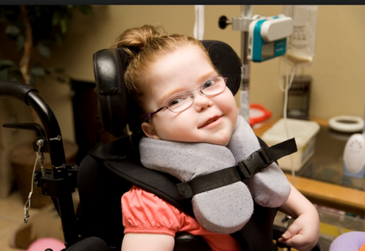
Definition: Developmental Disability
Any physical and/or mental disability that manifests before 22 years of age
Likely to continue indefinitely
Causes significant limitations on one or more life activities such as seeing, speaking, breathing, learning, or walking
Includes Asperger syndrome and autism, Down syndrome, Fragile X and other genetic syndromes, spina bifida, cerebral palsy, seizure disorders, ADHD, hearing and visual impairments, and traumatic brain injury
(Dauz Williams et al., 2010)
(CDC, 2015a)

Slide 3

Prevalence of Developmental Disabilities in U.S. Children 1997-2008
About 1 in 6 children in the U.S. had a developmental disability (DD) in 2006-2008
Prevalence of DD increased 17.1% from 1997 to 2008
Autism increased 289.5%
ADHD increased 33%
Males had twice the prevalence of any DD than females (specifically ADHD, autism, learning disabilities, stuttering/ stammering)
Children with Medicaid had two-fold prevalence of DD than those covered by private insurance
Lower prevalence among Hispanic children
(CDC, 2015)
Notes:
CDC published a study to determine the prevalence of disabilities in US children over a 12 year period

Slide 4
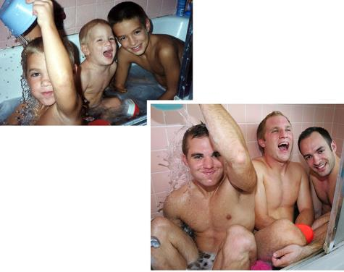
Significance of the sibling relationship
The sibling bond is potentially one of the most intense, normally lifelong, interpersonal relationship experienced by an individual.
This relationship has substantial influence on the development of a person’s identity, personality, and social skills.
The caregiving demands of a child with a DD has the potential to cause individual and family disruptions.
Family roles are reciprocal. Therefore, a significant change in one role alters related roles.
(Knecht, Hellmers, & Metzing, 2015)
(Dauz Williams et al., 2010)

Slide 5
How are siblings typically affected when they have a brother or
sister with a chronic illness (including a developmental disability)?
Much variability exists within sibling experiences.
60% of siblings are at risk for negative outcomes
30% of siblings are likely to have positive outcomes
10% of siblings have both negative and positive outcomes

Slide 6

“Children of Glass”
Worthless
Sad
Embarrassed
Angry
Afraid
Invisible
Resentful
Shameful
Isolated
Guilty
(Strohn, 2008)

Slide 7
These children at are risk for developing long-term psychological, physical, and emotional problems if not given the proper support.

Slide 8
Other children cope well with the challenges of having a disabled sibling and their lives are enriched by the experience.

Slide 9
Factors that Affect the Sibling Experience
Non-modifiable
Modifiable
Birth Order
Gender
Sibling Temperament
Type and Severity of Disability
Parent-Child Interactions
Sibling Relationships
Support from Grandparents and other extended family
Friends and peer relationships
Sibling perspectives

Slide 10
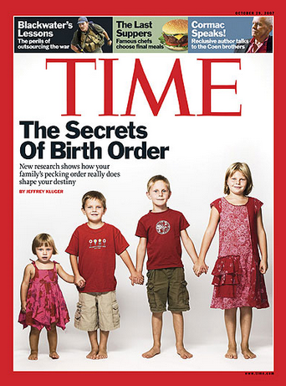
Birth Order
Proposes that sibling position predisposes children to certain personality traits and functional roles
Older siblings have greater power and status
Children with an older sibling with developmental disability may have poorer psychological adaptation.
Birth order may be significant to families when determining who will be legally responsible for the disabled child when parental authority is succeeded
(Toman, 1988)
(Choi & Van Riper, 2013)
Notes:
Walter Toman

Slide 11

Typical Social Roles adapted by siblings
Tendency of younger sibling to look up to and imitate older sibling
Capacity of older sibling to model and to initiate prosocial behavior for many subsequent years
(Knott, Lewis, & Williams, 1995)

Slide 12
Sibling Interaction of Children with Learning Disabilities: A Comparison of Autism and Down’s Syndrome
Home observations of 30 pairs of siblings with autism or Down syndrome
Observations confined to initiations, responses, and imitations
Among the Down syndrome dyads:
The nondisabled child took on the role of “teacher” or “leader” and the child with Down syndrome took on the role of “learner” or “follower” regardless of age or birth order.
This pattern of interaction gives both children access to channels of “normal” social development although there may be some disadvantage to the younger sibling assuming the role of the “older child”.
(Knott, Lewis, & Williams, 1995)

Slide 13
Sibling Interaction of Children with Learning Disabilities: A Comparison of Autism and Down’s Syndrome (continued)
Among the autistic dyads:
While the quality and quantity of play among siblings was greater than typical peer play for autistic children, impoverishment in interactions still existed as compared to the Down syndrome dyads (less initiation and imitation).
Why do autistic children “play better” with their siblings than with their peers?
  Siblings are highly familiar with each other and have similar backgrounds and experiences.
While peer play is egalitarian, sibling play is asymmetrical which may allow the autistic child to engage in play but not be responsible for initiation.
Siblings may be more motivated to play than peers and may receive encouragement and teaching from parents.
(Knott, Lewis, & Williams, 1995)

Slide 14
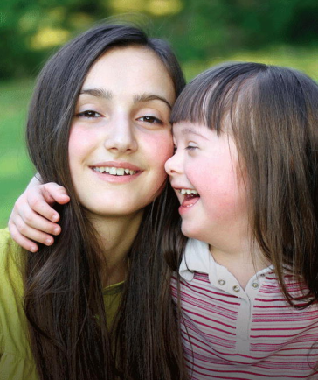
Gender
Among siblings of children with Down syndrome or other intellectual disabilities:
In 42% of the studies, sisters had more trouble adapting.
More behavioral problems (particularly conduct disorders)
More likely to be depressed and have low self-esteem
58% of the studies, brothers had more problems.
More likely to be depressed and/or display aggressive behaviors
Less likely to display prosocial behavior, nurturance, and affection for sibling
More emotional problems
(Choi & Van Riper, 2013)
Notes:
The aim of an integrative review by Choi and Van Riper was to understand the experience of siblings living with a child with Down syndrome and to identify factors that influenced sibling adaptation. Gender was associated with the extent of sibling adaptation but with mixed results.

Slide 15
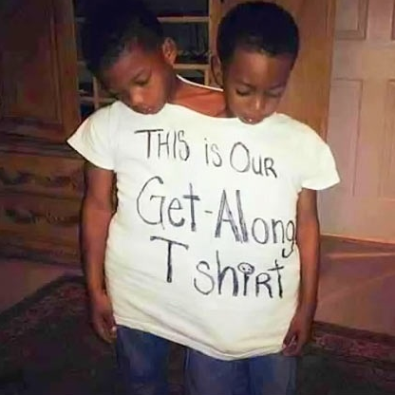
temperament, development, and family dynamics
Proposes that these variables will determine functional roles in family rather than birth order such as “the overly responsible one”.
These variables may also affect how close or distant siblings are to each other during various times of their lives.
May explain why some siblings are closer or more distant to disabled child (In extreme cases, siblings may de-identify with the affected child)
(Bank & Kahn, 1997)
Notes:
Michael Kahn
Such as “Who is the most responsible?”

Slide 16

Parent-Child Interaction

Slide 17

Early interactive patterns
Correlation between how a mother talks to their firstborn child about their newborn and the behavior between the siblings over a sustained period of time
The birth of a sibling is linked with a decrease in positive mother-child interactions, an increase in negative-controlling interactions, and an increase in behavior issues in the “displaced” child
Secure maternal attachment increases the likelihood for harmonious sibling relationships
Potential imbalances may occur in these patterns when a child is diagnosed with a developmental disability at an early age
(Baydar, Greek, & Brooks-Gunn, 1997)
(Martin, 1985)
(Schuntermann, 2007)

Slide 18
Convergence and Divergence
Convergence
Parents transmit patterns of thoughts and behaviors
Siblings will most likely resemble parents and each other
Divergence
Despite shared genetic pool and family background, siblings tend to be remarkably different from each other
These differences can be attributed to the nonshared environment that begins in utero and extends into adulthood
(Feinberg, McHale, Crouter, & Cumsille, 2003)
(Hetherington, Reiss, & Plomin, 1994)
Notes:
Two complementary perspectives in developmental research that help to explain the similarities and differences among siblings are convergence and divergence.

Slide 19

Parental differential treatment
Contributing factor to divergence hypothesis
Children very aware of the way they receive parental affection, attention, and discipline
Maternal differential treatment associated with hostile and conflicted sibling relationships
These patterns become evident in families under stressful situations such as marital difficulties, step-relationships, or illness.
In a three-year longitudinal study, Fisman demonstrated that siblings of children with pervasive developmental disorders (PDD) and Down syndrome had adjustment problems related to parental differential treatment
The siblings of the PDD group considered themselves the preferred children leading to feelings of guilt, anger, and anxiety.
The siblings of the Down syndrome group felt their siblings were the preferred children which led to feelings of neglect.
(Schuntermann, 2007)
(Fisman et al., 1996)

Slide 20

Parental and Marital Stress in families with a child with down syndrome
Degree of parental distress was associated with sibling adaptation among two groups of children (those with a sibling with Down syndrome and those without an affected sibling)
Parents of children with Down syndrome with depression or increased levels of stress were more likely to perceive that their typically developing children had behavior problems.
Siblings of children with Down syndrome were more likely to have deviant behavior problems at school and at home when their parents had less than satisfactory marital relationships.
(S. Fisman, Wolf, L., Ellison, D., Freeman, T., 2000)
(Stores, Stores, Fellows, & Buckley, 1998)
(Choi & Van Riper, 2013)

Slide 21
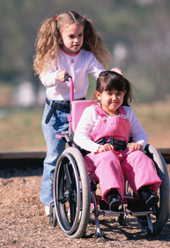
Healthy balance of responsibilities
Contradictory findings among studies reporting association between responsibilities and sibling adaptation.
Generally, positive consequences when sibling responsibilities (caregiving, household chores) are age- appropriate
Negative consequences if sibling expectations are more significant and sibling takes on a more parental role. This can lead to increased sibling conflict, behavior problems, and decreased personal autonomy of sibling.
Unaffected sibling may feel pressure to be an overachiever in a possible effort to compensate for parental grief
Because of sibling’s position of being “normal” he may refrain from expressing anger or emotional needs, and may not take opportunities for parental support or companionship so parent can take care of disabled sibling.
(Dunn, 1992)
(Choi & Van Riper, 2013)

Slide 22
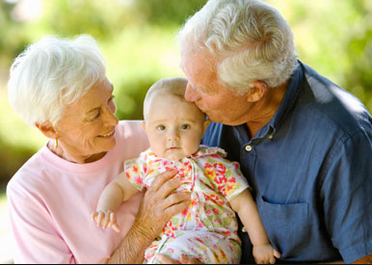
Grandparents and extended family
Extended family may be a source of emotional support for families
Absence of research on grandparents and children with disabilities
Research by Werner and Smith identified protective factors among children who thrived despite being surrounded by debilitating risk factors. Among these protective factors was emotional support from outside the immediate family.
Grandparents may grieve over loss of “ideal” grandchild which may compromise their availability
(Werner, 2001)
(Seligman, 1997)
Notes:
In 1955 Werner and Smith began a longitudinal study that followed all of the children born on the island of Kauwai that year until they were 40 years old. They found that some of the children in their study faced very adverse circumstances in their lives, yet 1/3 of them did very well. Werner and Smith called them “vulnerable but invincible”.
They found that those children with the most resiliency had access to protective factors such as sociability, autonomy, and emotional support

Slide 23

Friends and Peer Relationships
Positive peer relationships enhance self-worth and coping skills.
High-quality friendships is associated with leadership, sociability, and lower trait anxiety
Having a best friend can decrease peer victimization
Interplay between friendships and peer relationships is complex.
Negative sibling relationships may be associated with positive friendships.
Strong sibling relationships may result spending less time with friends.
Parental reports of 26 siblings with autism using Strengths and Difficulties Questionnaire
  Assessed conduct problems, emotional problems, hyperactivity, and peer problems
  Younger brothers of children with autism had the most psychosocial and peer problems.
(Griffith, Hastings, & Petalas, 2014)
(Dunn, 1993)

Slide 24
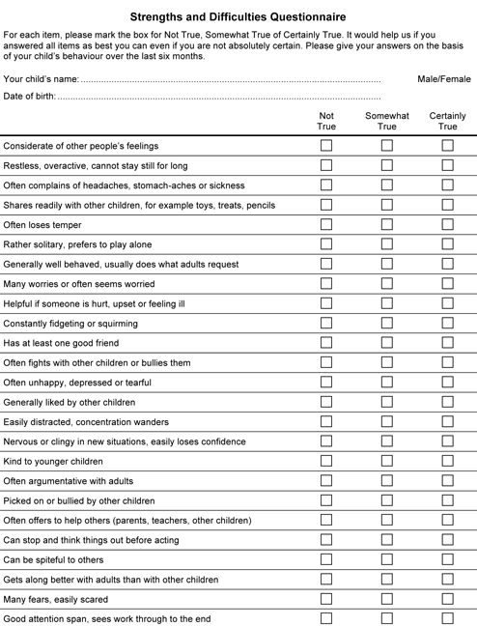
Strengths and Difficulties Questionnaire

Slide 25

Contributors to Sibling Vulnerability
Parental neglect and preoccupation
Parental stress
Lack of support and resources
Concern over own physical or psychological well-being
Worry about catching sibling’s disability
Concern over future health in the case of genetic condition
Poor perception of own social competence
Severity of sibling’s disability
(Schuntermann, 2007)
(Schwartz, 2003)
Notes:
Perception of own social competence related to autistic sibling’s social skills

Slide 26

Contributors to sibling resilience
Individual attributes
    Social competence
    Good judgment
    Intelligence
    Self control
Family Strengths
Effective communication
Close relationships
Consistent rules/boundaries
Community support
Friends
School
Extended family
(Schuntermann, 2007)

Slide 27

Clinical Implications
Gold standard for health professionals is to provide family-centered, compassionate, comprehensive, and culturally-competent care.
Family-centered care includes attending to the experiences and well-being of the sibling by:
  Having an awareness of the sibling’s increased risk, factors that contribute to that risk, and possible negative behaviors that may be displayed by the sibling
Exploring with parents and siblings both the positive and negative effects of the sibling experience
Communicating effectively and sensitively with parents and siblings
Being knowledgeable about available resources for parents and siblings
(Dauz Williams et al., 2010)
(American Academy of Pediatrics, 2002)

Slide 28
Gaining the sibling perspective
What is the sibling’s current understanding of the developmental disorder and its overall impact?
What is the sibling’s current experience? What impact does the disorder currently have on the unaffected sibling and the rest of his or her family?
How do siblings perceive their family’s ability to solve problems and to provide support to them and to the rest of the family?
The cognitive perspective (What is the family’s understanding of the illness?)
The emotional perspective (How do individual family members manage their feelings in respect to symptoms of the affected child?)
The perspective of effective family action (How do families discuss and solve problems related to the illness and how do they manage stress?)
What is the sibling’s understanding of the developmental order across time? Do they think about how they will be involved in their disabled brother or sister’s life in the future?
(Schuntermann, 2007)
(Hauser et al., 1993)
Notes:
Often the sibling’s understanding of impact is limited to how they are impacted.
What is their sense of well-being? How are things at home? What does their family do for fun? How is their relationships with their friends? Are they ever embarrassed by their sibling?
Hauser et al proposed a 3 component problem solving strategy for famlies who have children with juvenile diabetes. Problem solving strategies are key in shifting the balance from vulnerability to resilience.
The sibling experience may vary over time depending on the developmental progress of the affected child and on the understanding of the unaffected sibling

Slide 29
References
American Academy of Pediatrics, A. A. o. F. P., and American College of Physicians-American Society of Internal Medicine,. (2002). A consensus statement on helath care transitions for young adults with special health care needs. Pediatrics, 110, 1304-1306.
Bank, S. P., & Kahn, M. D. (1997). The sibling bond. New York, NY, US: Basic Books.
Baydar, N., Greek, A., & Brooks-Gunn, J. (1997). A longitudinal study of the effects of the birth of a sibling during the first 6 years of life. Journal of Marriage and the Family, 59(4), 939-956. doi: 10.2307/353794
Boszormenyi-Nagy, I., Spark, G.M. (1973). Invisible Loyalties. New York: Harper & Row.
CDC. (2015a). Facts About Developmental Disabilites. from http://www.cdc.gov/ncbddd/developmentaldisabilities/facts.html
CDC. (2015b). Key Findings: Trends in the Prevalece of Developmental Disabilities in U.S. Children, 1997-2008. from http://www.cdc.gov/ncbddd/developmentaldisabilities/features/birthdefects-dd-keyfindings.html
Choi, H., & Van Riper, M. (2013). Siblings of children with Down syndrome: an integrative review. MCN Am J Matern Child Nurs, 38(2), 72-78. doi: 10.1097/NMC.0b013e31826bad8e
Dauz Williams, P., Piamjariyakul, U., Graff, J. C., Stanton, A., Guthrie, A. C., Hafeman, C., & Williams, A. R. (2010). Developmental disabilities: effects on well siblings. Issues Compr Pediatr Nurs, 33(1), 39-55. doi: 10.3109/01460860903486515
Dunn, J. (1993). Young children's close relationships: beyond attachment. Newbury Park, CA: Sage.
Feinberg, M. E., McHale, S. M., Crouter, A. C., & Cumsille, P. (2003). Sibling differentiation: Sibling and parent relationship trajectories in adolescence. Child Development, 74(5), 1261-1274. doi: 10.1111/1467-8624.00606
.

Slide 30
References
Fisman, S., Wolf, L., Ellison, D., Gillis, B., Freeman, T., & Szatmari, P. (1996). Risk and protective factors affecting the adjustment of siblings of children with chronic disabilities. J Am Acad Child Adolesc Psychiatry, 35(11), 1532-1541. doi: 10.1097/00004583-199611000-00023
Fisman, S., Wolf, L., Ellison, D., Freeman, T. (2000). A longitudinal study of siblings of children with chronic disability. Canadian Journal of Psychiatry, 45(4), 369-375.
Griffith, G. M., Hastings, R. P., & Petalas, M. A. (2014). Brief report: Fathers’ and mothers’ ratings of behavioral and emotional problems in siblings of children with autism spectrum disorder. J Autism Dev Disord, 44(5), 1230-1235. doi: 10.1007/s10803-013-1969-6
Hauser, S. T., Jacobson, A. M., Bliss, R., Milley, J., Vieyra, M. A., Willett, J. B., . . . Paul, E. (1993). The family and the onset of its youngster's insulin-dependent diabetes: Ways of coping. In R. E. Cole, D. Reiss, R. E. Cole & D. Reiss (Eds.), How do families cope with chronic illness? (pp. 25-55). Hillsdale, NJ, England: Lawrence Erlbaum Associates, Inc.
Hetherington, E. M., Reiss, D., & Plomin, R. (1994). Separate social worlds of siblings: The impact of nonshared environment on development. Hillsdale, NJ, England: Lawrence Erlbaum Associates, Inc.
Knecht, C., Hellmers, C., & Metzing, S. (2015). The perspective of siblings of children with chronic illness: a literature review. J Pediatr Nurs, 30(1), 102-116. doi: 10.1016/j.pedn.2014.10.010
Knott, F., Lewis, C., & Williams, T. (1995). Sibling interaction of children with learning disabilities: a comparison of autism and Down's syndrome. J Child Psychol Psychiatry, 36(6), 965-976.
Martin, J. A. (1985). Review of Siblings: Love, Envy, and Understanding. Journal of Social and Personal Relationships, 2(2), 239-240. doi: 10.1177/0265407585022008

Slide 31
References
Mikesell, R. H., Lusterman, D. & McDaniel, S. H. (1995). Integrating family therapy: Handbook of family psychology and systems theory. Washington, DC: American Psychological Association.
Schuntermann, P. (2007). The Sibling Experience: Growing Up with a Child Who Has Pervasive Developmental Disorder or Mental Retardation. Harvard Review of Psychiatry (Taylor & Francis Ltd), 15(3), 93-108. doi: 10.1080/10673220701432188
Schwartz, R. C. (2003). Resiliency in siblings of autistic children. (64), ProQuest Information & Learning, US. Retrieved from http://search.ebscohost.com/login.aspx?direct=true&AuthType=ip,uid&db=psyh&AN=2003-95022-326&site=ehost-live&scope=site Available from EBSCOhost psyh database.
Seligman, M., Darling, R. (1997). Ordinary famlies, special children (2nd ed.). New York: Guilford.
Stores, R., Stores, G., Fellows, B., & Buckley, S. (1998). Daytime behaviour problems and maternal stress in children with Down's syndrome, their siblings, and non-intellectually disabled and other intellectually disabled peers. Journal of Intellectual Disability Research, 42(3), 228-237.
Strohn, K. (2008). Too important to ignore: siblings of children with special needs. Austrailian E-Journal For The Advancement of Mental Health, 7(2).
The Fowler 4 Group. (2012). The Fowler 4 Group-Siblings and The Autism Spectrum. from https://http://www.youtube.com/watch?v=VTZ_BJlh8LU
Timme, S. (2013). What it's like to have a Brother with Autism. from https://http://www.youtube.com/watch?v=QHC0FzywHGY

Slide 32
References
Toman, W. (1988). Basics of family structure and sibling position. In M. D. Kahn, K. G. Lewis, M. D. Kahn & K. G. Lewis (Eds.), Siblings in therapy: Life span and clinical issues. (pp. 46-65). New York, NY, US: W W Norton & Co.
Werner, E., Smith, R. (2001). Journeys from childhood to midlife: risk, resilience and recovery. Ithaca, NY: Cornell University Press.
Williams, P. D. (1997). Siblings and pediatric chronic illness: a review of the literature. International Journal of Nursing Studies, 34(4), 312-323.

