Slide 1
Using Effective Communication and Family-Centered Strategies to Improve Health Literacy
Sarah Berger, Social Work Trainee
UW-Madison Pediatric Pulmonary Center
May 10, 2016

Slide 2

Recognized Need
Clinic Visit
New Information
Apparent Understanding
Next Visit Follow -Up
Review of Information and Routine
Non-Adherence
Apparent Understanding

Slide 3
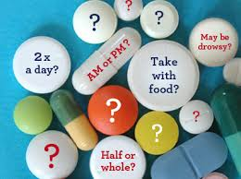
Health Literacy Is…
“the degree to which individuals have the capacity to obtain, process, and understand basic health information and services needed to make appropriate health decisions” (Nielsen-Bohlman et al., 2004, p. 4).
“represents the cognitive and social skills which determine the motivation and ability of individuals to gain access to, understand and use information in ways which promote and maintain good health” ( World Health Organization in du Pre, 2010).
Notes:
Literacy skills are the strongest predictor of health status more than age, income, or education level. Only 12 percent of Americans are proficient in health literacy. While 43 percent of the population reads at low literacy levels, 88 percent of the population struggles with health literacy

Slide 4
Original Thought Process
Evaluations
Assessments
Health Literacy
Family-Provider
Communication
Current Tools
Increased Adherence

Slide 5
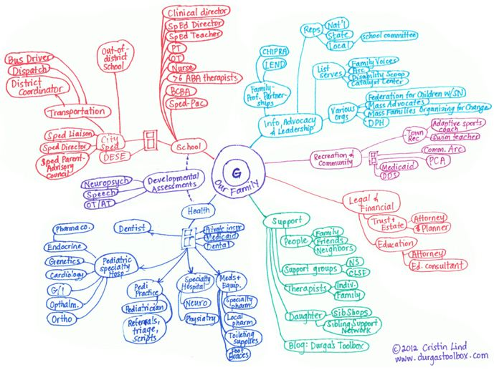
Care Map for a Child with Special Health Care Needs
Notes:
80 percent of patients forget what the doctor tells them as soon as they leave the office, and 50 percent of what patients recall is incorrect.

Slide 6
New Framework
Treatment Adherence
Health Literacy
Social Determinants of Health
Family-Provider Communication
Family Characteristics
Notes:
In light of findings in literature and observations of families in clinic and during family mentoring activity, Now more of a needs assessment, any one of these areas could pertain to its own project. Assess gaps in current literature and provide recommendations for future directions.

Slide 7
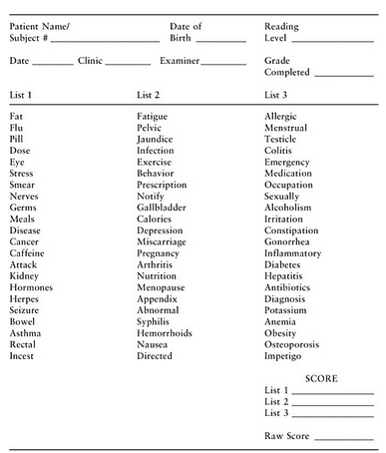
Rapid Estimate of Adult Literacy in Medicine (REALM)
Notes:
Rapid Estimate of Adult Literacy in Medicine (REALM)
66 medical terms, 2 minutes
Assesses ability to pronounce medical terms

Slide 8
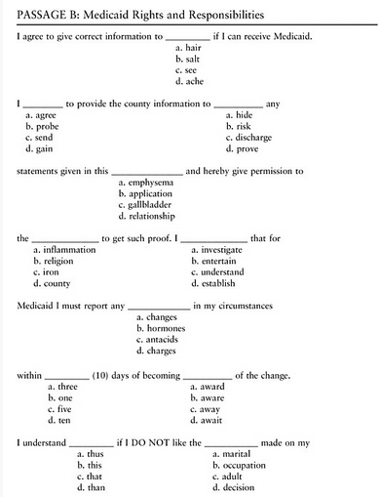
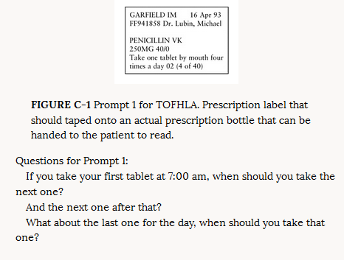
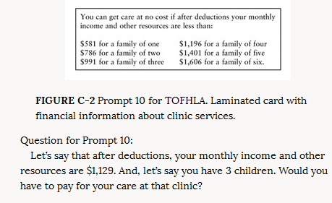
Short Test of Functional Health Literacy in Adults
Notes:
Short Test of Functional Health Literacy in Adults (S-TOFHLA)
Part 1 assesses literacy and numeracy
Part 2 is a fill-in-the-blank medical form

Slide 9
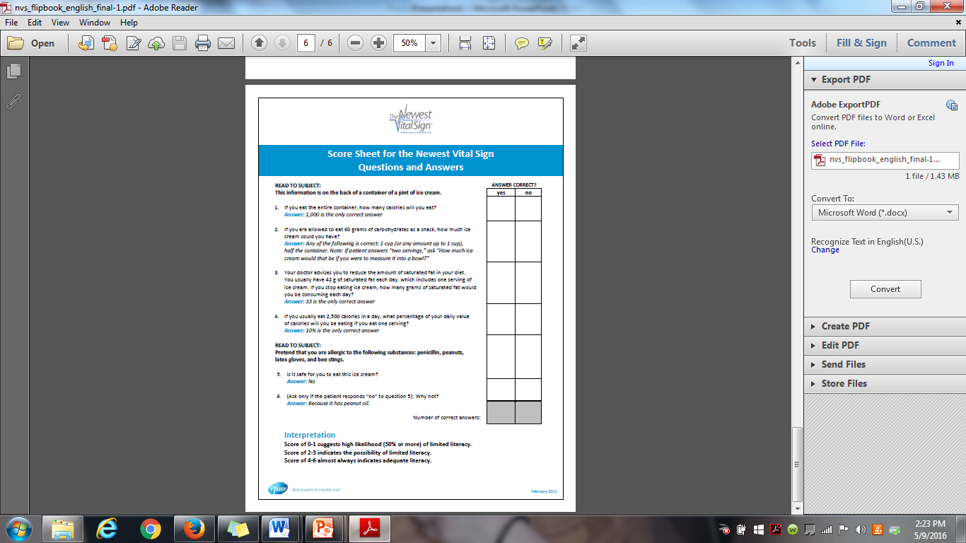
Notes:
Newest Vital Sign
6 questions assessing ability to read and interpret ice cream nutrition facts label.
89 percent of surveyed patients said literacy assessments would be useful, but 33 percent said use of the above assessments in a clinic setting would make people uncomfortable
“Non-threatening” methods

Slide 10
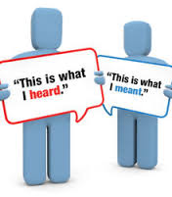
Literature Review: Interventions
Plain Language: communication your audience can understand the first time they read or hear it.
Teach Back: Asking patient/caregiver to repeat back health information or treatment recommendations to assess for understanding.
Ask Me 3: Tool for patients to ask providers 3 questions: What is my main problem? What do I need to do? Why is it important for me to do it?

Slide 11
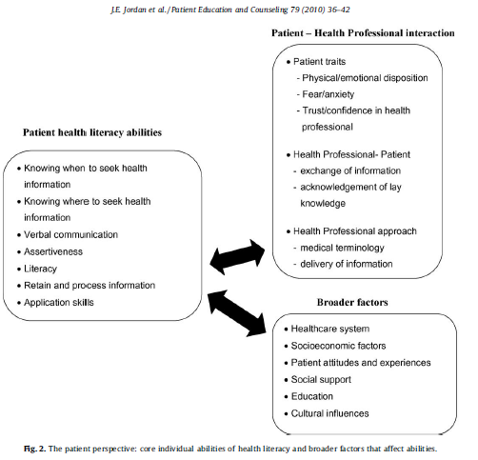

Slide 12

Current Practices at UWHC and AFCH
UW Hospital Learning Center
Patient/Caregiver health literacy assessment non-existent
Assume basic/low health literacy of all
Written tools created using CDC Guidelines for Plain Language
Departmental Review of Practices and Materials
“Duplicitous” information
Inconsistent information across sources
Appropriate reading level but low applicability
Patient/caregiver learning style assessed, but information not tailored to individual
Notes:
Personal interview with Melissa Perkins (Manager of Learning Center) April 2016

Slide 13
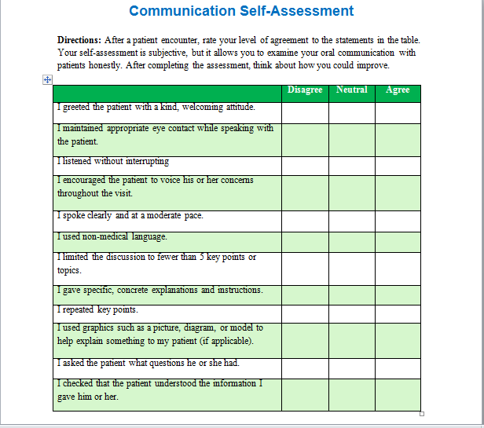
Notes:
Agency of Healthcare Research and Quality Universal Precautions Toolkit, WI Health Literacy

Slide 14
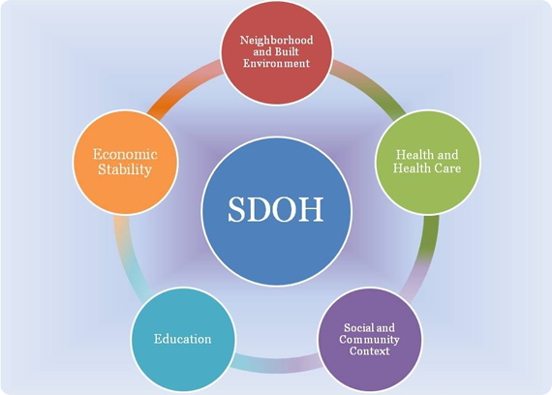
Social Determinants of Health: Department of Health Services
Notes:
Housing, income, employment status, access to transportation, food security, access to quality health care, insurance status, cultural background, discrimination, social support

Slide 15
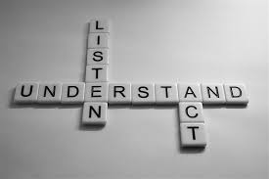
Recommendations
Personalization of tools based on learning style
Biopsychosocial(spiritual) assessment
Assess explanatory models and health beliefs
Routines based interview and reframe Ask Me 3
Communication techniques
Address caregiver stress, mental health, and social support
Notes:
Providers can find out the existence of these other barriers to effective care and strength in health literacy by building a relationship based on respect and empathy, demonstrating an interest in the psychosocial environment, and actively listening. It is important to elicit questions from the patient as well. Invite questions through nonverbal behavior such as body language, position, and active listening. It is important to respectfully solicit questions, help patients to form those questions, and clearly make time for those questions to be answered. They can then help to provide resources to alleviate stressors and problem solve with the family, and provide patient and family centered care by acknowledging stressors and addressing the unique needs of each patient
: “What do you see as your main issue or concern? Why is this important to you? What will work for you?” This allows the family to feel like a valuable part of the interdisciplinary team and make sure their perspective is heard. The interdisciplinary team can then explain the way they see the issue and an agreement can be reached.
Special attention should also be paid to caregiver mental health and stress. The Cystic Fibrosis Foundation is mandating the implementation of mental health screenings into clinic appointments, and this is a good first step. Caregiver stress should be continually evaluated by the interdisciplinary team. Allow time for caregivers to express their emotions and encourage involvement of formal and informal social supports. Recommending support groups and online communities may be appropriate. Suggesting caregivers bring another trusted adult, such as a family member, friend, spiritual leader, or the child’s therapist to appointments may help with correct recall of information as well. The implementation of some of the above recommendations should help to alleviate caregiver stress by making sure recommendations are in line with the caregiver’s abilities and that the caregiver’s thoughts and concerns are heard.

Slide 16
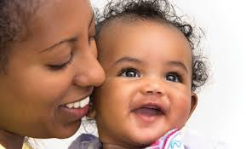

Connection To Maternal Child Health Leadership Competencies
Self-Reflection
Critical Thinking
Communication
Cultural Competency
Family-Centered Care
Interdisciplinary Team Building
Working with Communities and Systems

Slide 17
References
Abrams, M.A. and Dreyer, B. (eds.). (2009). Plain language pediatrics: Health literacy strategies and communication resources for common pediatric topics. Illinois: American Academy of Pediatrics.
Boavida, T., Aguiar, C., & McWilliam, R. A. (2014). A training program to improve IFSP/IEP goals and objectives through the routines-based interview. Topics In Early Childhood Special Education, 33(4), 200-211.
Cifuentes, M., et al. (2015). Guide to implementing the health literacy universal precautions toolkit. Rockville, MD: Agency for Healthcare Research and Quality.
du Pré, A. (2010). Communicating about health: Current issues and perspectives (3rd ed.). New York: Oxford University Press.
Ferguson, B., Lowman, S.G., and DeWalt, D.A. (2011). Assessing literacy in clinical and community settings: The patient perspective. Journal of Health Communication, 16, 124-134.
Horky, S. et al. (2009). Core concepts in cultural competence. PPC Cross Cultural Health Care Case Studies. Retrieved from http://support.mchtraining.net/national_ccce/case0/home.html
Jordan, J.E., Buchbinder, R., and Osborne, R.H. (2010). Conceptualizing health literacy from the patient perspective. Patient Education and Counseling, 79, 36-42.
Keil, F.C. (2006). Meeting the literacy needs of young children. In: Proceedings from the surgeon general’s workshop on improving health literacy. Bethesda, MD.

Slide 18
References
Kessels, R. C. (2003). Patients' memory for medical information. Journal of the Royal Society of Medicine, 96(5), 219-222.
Kutner, M., Greenberg, E., and Baer, J. (2005). A first look at the literacy of America’s adults in the 21st century. Washington, D.C.: National Center for Education Statistics, U.S. Department of Education.
McCall, J. and Wilson, C. (2015). Promoting health literacy in an HIV-infected population: Creating staff awareness. Journal of the Association of Nurses in AIDS Care, 26(4), 498-502.
Nielsen-Bohlman, L., Panzer A.M., and Kindig, D.A. (eds.). (2004). Health literacy: A prescription to end confusion. Washington, D.C.: The National Academies Press.
Pleasant, A., Cabe, J., Patel, K., Cosenza, J., and Carmona, R. (2015). Health literacy research and practice: A needed paradigm shift. Health Communication, 30, 1176-1180.
Vernon, J.A., Trujillo, A., Rosenbaum, S., and DeBuono, B. (2007). Low health literacy: Implications for national health policy. 1-18. Retrieved from www.npsf.org/resource/collection/9220B314-9666-40DA-89DA-9F46357530F1/AskMe3_UConnReport_LowLiteracy.pdf
Weiss, B. (2015). Health literacy research: Isn’t there something better we could be doing? Health Communication, 30, 1173-1175.
Wisconsin Literacy. (2016). Wisconsin health literacy. Retrieved from http://wisconsinliteracy.org/health-literacy/index.html

