Slide 1
Physical Activity in Pediatric CF:
Melding Research in Practice
Rachel Bell, MS, RD
PPC Nutrition Trainee 2012-2013

Slide 2
Outline
The Backstory
  Why this topic?
The Science
  What does the literature say?
The Field
  What is happening at other pediatric CF centers?
  What is happening at AFCH?
The Next Step
  Where do we go from here?

Slide 3
The Backstory
My perspective
  Registered dietitian with a masters in exercise physiology
  AFCH and with UW Athletics
  Competitive runner/triathlete for 15+ years
My observations
  Exercise is beneficial for CF patients
  Maintaining healthy lifestyles habits is difficult for everyone
  Are we optimally promoting exercise for CF patients at AFCH?
Notes:
What providers are heading up exercise promotion at AFCH?
And how do we compare to other CF centers?
QOL and longevity

Slide 4
The Science
Physical Training for Cystic Fibrosis (Review), 2011
  Cochrane Cystic Fibrosis and Genetic Disorders Group
Purpose:
  “To determine whether a prescribed regimen of physical training produces improvement or prevents deterioration in physiological and clinical outcomes in cystic fibrosis compared to no training.”
Conclusions:
  “…are limited by the small size, short duration and incomplete reporting of most of the studies included in this review.”
  “Physical training is already part of the care package offered to most people with cystic fibrosis and there is a lack of evidence to actively discourage this.”

Slide 5







The Science
Notes:
In children, increased habitual physical activity is associated with a slower rate of decline in lung function (FEV1). Hebestreit H, Kieser S, Rüdiger S, Schenk T, Junge S, Hebestreit A, et al. Physical activity is independently related to aerobic capacity in cystic fibrosis. Eur Respir J. 2006 Oct;28:734–739
Exercise is medicine – improve clinical outcome, but have been unable to demonstrate mechanistic action at cellular level/ion regulation

Slide 6
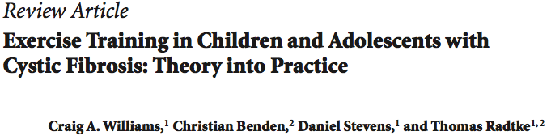
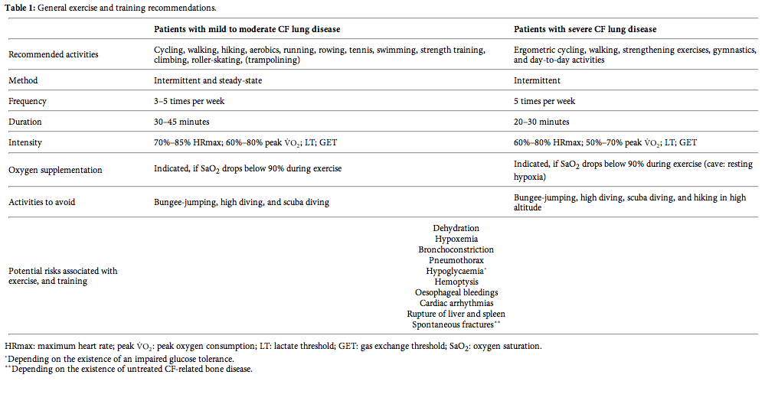
International Journal of Pediatrics
Volume 2010 (2010), Article ID 670640, 7 pages

Slide 7
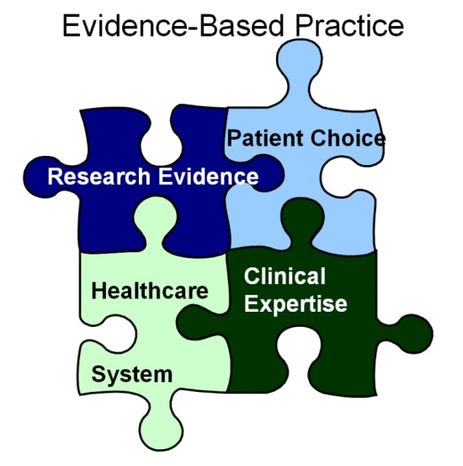
Keele University
Staffordshire, England

Slide 8
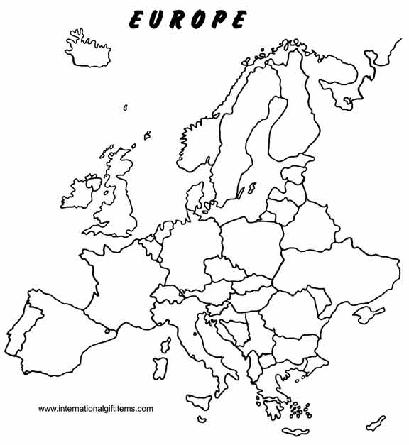
Europe
.

Slide 9
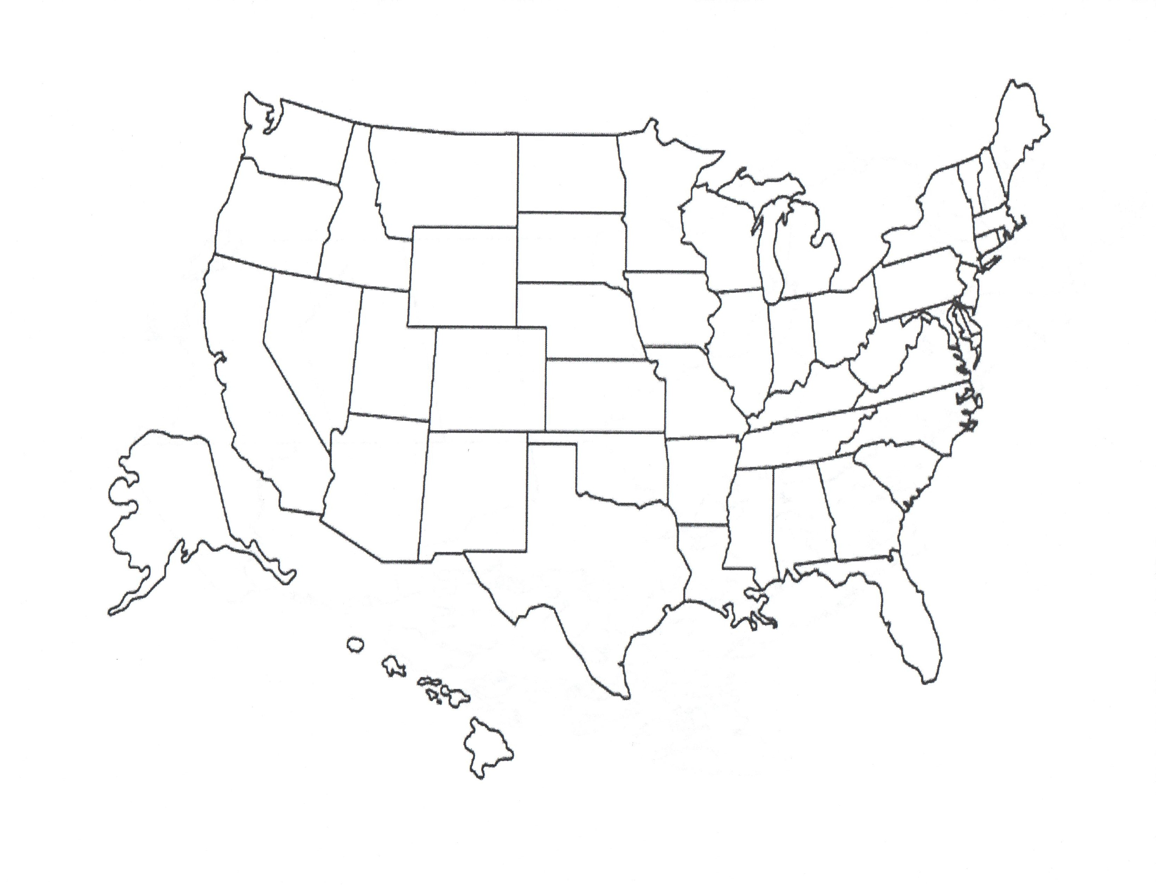
North America

Slide 10
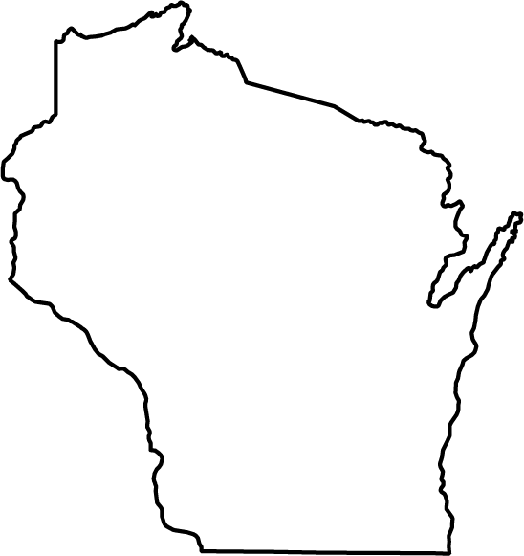
Wisconsin

Slide 11
Interview Questions
Which provider(s) discuss exercise in your clinic?
Do you have handouts that patients take home?
Do your providers receive additional training in exercise prescription for CF patients?
On what exercise-related topic do CF patients most often need more information?
Do you have any other tips that would be helpful for us to know?
Notes:
Role of RD
PT on staff
Experiences in exercise promotion

Slide 12
Europe
.

Slide 13
England
Sean Ledger (Physiotherapist), Sarah Rand (Physiotherapist), Liz Owen (PhD, RD) - Great Ormand Street Hospital for Children, London
Exercise addressed with patients:
  All outpatient visits and inpatient admissions
  Annual review assessment day – children >5 years complete VO2max test
Community education for:
  Personal trainers, PE teachers, school/nursery teachers, and leisure center staff
  “CF study day” for physios
“From our experience it is clear that children and families need facilitation as well as education to participate in appropriate exercise training.”
Notes:
developing videos instead of handouts
educating PE that ok to exercise if coughing & no need to make CF child a goalie
Facilitating Ex - locating gym membership scholarships, classes nearby, grants for equipment, established parental role mode

Slide 14
England
On maximal exercise testing:
  “If you don't test, how can you prescribe?”
  Kids are healthier now - need a more maximal test
  Opportunity to education kids on “normal” sensations during exercise
  6 min walk test - okay for severe disease
Airway Clearance
  Healthy: exercise + 1 AC daily
  With respiratory symptoms: exercise + 2 AC daily
Sick days
  No high intensity exercise with a fever
  Inpatient: lower intensity and shorter bouts
    2 AC + 1 exercise daily

Slide 15
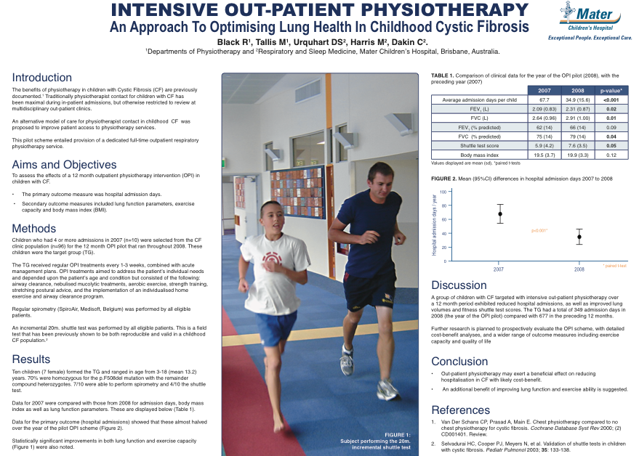
London
Notes:
Frequent Flyer: pilot of 16 most severe kids, QI project
See data in the NA CF Conference or European CF conference
The most common barriers to exercise are probably kids simply not having a good experience with exercise. It has to be fun, dynamic and keep them entertained.
Personal training is a brilliant approach to training the kids - they think it's cool to have a trainer! Helping the kids find a sport they can excel at and pushing them out of their comfort zones goes a considerable way to improving their confidence, and they very quickly realise that they are able to partake in sport at the same level as their peers. This is true for children with FEV1 %pred in the 50-60% range too.

Slide 16
England
INSPIRE CF
  Ongoing randomized controlled trial, funded Nov 2012 to Apr 2015
  To date, 66 of 178 possible children recruited (range of disease severity)
  Group 1 (control)
    Standard specialist care
  Group 2 (intervention)
    Specialist care plus a weekly supervised exercise training session at their local fitness facility
  Primary outcome measures:
    VO2Peak
    Anaerobic Threshold
    FEV1, FVC, LCI
    CF Questionnaire as a measure of QOL
Notes:
Gym Collaboration:
- membership for free. PT sessions free 1-2x/wk
- 60 children participating
- infants-swim, toddlers-play, older children-strunctured
- parents can attend PT session
- media attention for gym, specialized training for PTs
RDs monitoring weight and BMI
Our 'trainers' (physio's and sports scientists) provide an outreach service and drive out to the children to exercise them

Slide 17
Scotland
Lisa Morrison, physiotherapist – Gartnavel General Hospital, Glasgow
Primary provider: physiotherapists
  Type and frequency of activity
  How kids feel compared to their peer group when engaging in activity
Hand-outs:
  Postural leaflet
  Interest-specific handouts, as requested
Most frequent questions:
  Males: strength training
  Females: tone up the mid section
Notes:
I also appreciate that any one of the other members of the MDT may also ask this question and however I am not sure how they follow up the question.
“…they want to ‘bulk up’ a little as they frequently complain of being too slim.”
“…to improve their overall body image, thus moving away from stick arms and legs and rounded tummy.”

Slide 18
Scotland
Other common concerns
  Management of hemoptysis
    Limit resistance exercises for the upper limbs
  Exercise-induced bronchospasm or desaturation
    Pre-medication and supplemental oxygen, as needed
  Pregnancy and pre-transplant
    Individualized focus on maintenance of function
  Hydration
    Salt replacement therapies if doing endurance activities
  Blood glucose management
    For diabetic patients, as needed

Slide 19
North America

Slide 20
Canada
Maggie Mcllwaine, Physiotherapist – British Columbia Children’s Hospital, Vancouver
In Canada:
  Physiotherapists are responsible for exercise prescription, airway clearance and nebulization for CF patients
Exercise recommendations:
  Babies/toddlers: exercise handouts
  School-age children: encourage exercise groups or sports
Exercise goal:
  Canadian exercise guidelines of 60 min cardio per day for children
  “Most of our kids exceed this. We have measured this by using the Habitual Activity Estimation Scale” (data to be presented and published)
Notes:
Posture used to be a big problem area, hoever with better lung function, it is not so much a problem. Stretching is a problem, a lot of CF patients have tight hmstrings so we stretch these.

Slide 21
Canada
Exercise promotion tips:
  Find out what they enjoy doing best
    Teenage boys: add cardio to weight lifting
    Teenage girls: “are the worst” - start early to make exercise a habit
  Inpatient: Wii and other computer games for exercise
  Get the whole family involved in outdoor activity
Notes:
Posture used to be a big problem area, hoever with better lung function, it is not so much a problem. Stretching is a problem, a lot of CF patients have tight hmstrings so we stretch these.

Slide 22
West Virginia
Anne Swisher, PT - West Virginia University
Physical activity is “undervalued” in CF population
  Improves disease outcomes
  Anti-inflammatory
  Feels good
  Maximizes lean mass with goal BMI > 50th %ile
Exercise as airway clearance:
  Not all exercise is AC
  Exercise is more than AC
  AC compliance is 25-50%. “If you'll exercise, we'll do that.”
Notes:
CF PT 20-25 yrs
PhD exercise physiology
Not just a nice this to do if you have time. PA is treatment!!
AC: breath deeper volumes, more, & clear mucous

Slide 23
West Virginia
Coaching pilot study*:
  12 pre-teens
  Surveyed pre/post 3 month intervention
  Given pedometer with 10,000 steps/day goal
  Weekly follow-up phone calls
  Modest improvement in physical & social health
CF Foundation PT mentoring program
  CF 101 for the Physical Therapist
* Swisher, AK., Moffet, K. The Effect of Coaching on Physical Activity and Quality of Life in Children
and Adolescents with Cystic Fibrosis: A Quality Improvement Pilot Study. April 2010. Volume 8 Number 2.
Notes:
(PA and CF questionnaires)

Slide 24
Minnesota
Julie Christiansen, PTA – Children’s Hospital and Clinics of Minnesota
  The field is evolving:
    “RT is doing most exercise education. PTs are doing less.”
  Handouts:
    LIFE handout for each age group
  Recent research:
    Core strength and rib cage mobility
    VO2max >FEV1 for exercise tolerance & life expectancy
  Early intervention is key:
    Ask about stress incontinence (muscle weakness)
    Ask about musculoskeletal pain (muscle imbalances)
Notes:
Field is gradually evolving. More accepted that "Exercise is treatment."
Port CF - 5 handouts. LIFE with CF 0-1, 1-3 - RD or SW give handouts at the visits
No PT in clinic
Pilates, stretches on foam roller, manual manipulation Manuscript still in progress.

Slide 25
Wisconsin

Slide 26
Green Bay
Tammy Summers, RD
  “While we encourage physical activity (sports or play), I can't say that we really have a formalized process.”
  “Our respiratory therapist is trying to set up inpatient/outpatient cardiopulmonary rehabilitation and putting together a more formalized exercise regimen since that really seemed to be the buzz at NACFC”
Notes:
PT on outpatient staff? – No
Written materials on CF & exercise – No

Slide 27
Marshfield
Tammi Timler, RD
  “Our respiratory therapists see patients at each visit and discuss exercise.”
Karen Masanz, RT
  “If a patient wants to replace their AC for exercise they need to do 1 hour of aerobic exercise for each treatment.”
  “We talk about walking, sports, weights, whatever they like. We discuss how it helps them to take deeper breaths and keeps the secretions moving. We have no set protocol that we use.”
Notes:
PT on outpatient staff? – No
Written materials on CF & exercise – No
I do not know if our new peds pulmonologist is OK with the substitution yet because we have not had one of our pts in yet that only exercises.

Slide 28
La Crosse
Margie Ley, RD
  “I haven't been focusing on this other than to encourage our patients to be active, but nothing specific.”
  “The only thing we are doing is that our respiratory therapist has an incentive game she plays with the younger kids. Other than that no one is really taking ownership with this.”
  “We all agree we need to do more and will be interested in your ideas.”
Notes:
PT on outpatient staff? – No
Written materials on CF & exercise – No

Slide 29
Milwaukee
Tami Miller, RD
  Children – “most are active in organized sports or are playing outside, so I'm not as assertive in promoting scheduled exercise.”
  Older the teens and young adults - “our adult CF doctor and I are most likely to discuss exercise in a directed conversation, especially when we feel that the patient is playing video games a lot and has decreased lung function.”
  “I think the balance between good nutritional status and exercise are well connected, but I don't feel particularly skilled in guiding specific exercises or activity other than in general terms.”
Notes:
“…the overall answer is that it is very random and patient specific”
PT on outpatient staff? – No
Written materials on CF & exercise – No

Slide 30
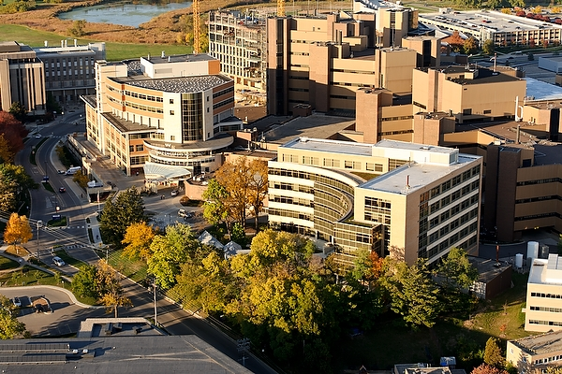
Madison

Slide 31
AFCH Inpatient
Nicole Gotta, PT
  CF reference binder
  Baseline testing (step test) at admission
  No handouts typically given

Slide 32
Pulmonary Provider Survey

Slide 33
Pulmonary Provider Survey

Slide 34
Pulmonary Provider Survey

Slide 35
Pulmonary Provider Survey

Slide 36
Patient/Family Survey

Slide 37
Patient/Family Survey

Slide 38
Patient/Family Survey

Slide 39
The Application
Seek opportunities for provider education
  Webinars
  Conferences
  Relevant journals
Provide handouts to patients
  Utilize existing vs develop new one
  Know local resources for physical activity
Communicate workflow and establish lead providers for exercise promotion

Slide 40
Available Resources
CFF videos for patients
  Yoga for CF
  Exercise Your Future-Staying Fit with CF
Port CF education materials
  Day to Day exercise
  LIFE handouts
Postural leaflet
CF 101 for the Physical Therapist

Slide 41
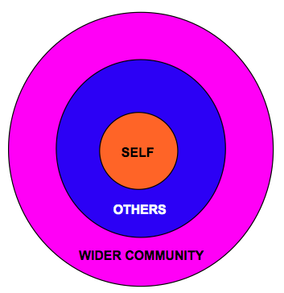
MCHB Competencies

Slide 42
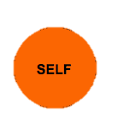
MCHB Competencies
MCHB Knowledge Base
  Core Values/Strategic Objectives focus on:
      Women, families and children
      Prevention
      Cultural competence
      Family-centered care
      Evidence-based practice

Slide 43

MCHB Competencies
Communication
  Listening, writing, speaking
Cultural competency
  Acknowledging personal bias, social/ethnic influences on physical activity, differences in health care system structure
Family centered care
  Soliciting patient/parent input through surveys
Developing others through teaching
  Presenting capstone and sharing information with WI CF centers
Interdisciplinary team building
  Learning from AFCH providers through online survey
Notes:
Communication – phone (listening), email (writing), presenting (speaking)
Culture – personal bias, cultural/ethnic influences on PA, healthcare systems
Family – patient/parent input in development, meet their needs
Teaching – capstone presentation, share with other WI centers
Team – provider survey, learning from each of the disciplines

Slide 44
Thank You
Mary Marcus
AFCH pulmonary providers
AFCH patient and families
The 12+ contributing PTs, RTs and RDs

Slide 45
Questions?

