Slide 1
Recommendations for Addressing Obesity in Pediatric Asthma Patients
Andrea Magee, RD
Pediatric Pulmonary Center Nutrition Trainee 2013-2014

Slide 2
Overview
Background
Expert Guidelines
Current Practices
Recommendations for Pediatric Specialty Clinics

Slide 3
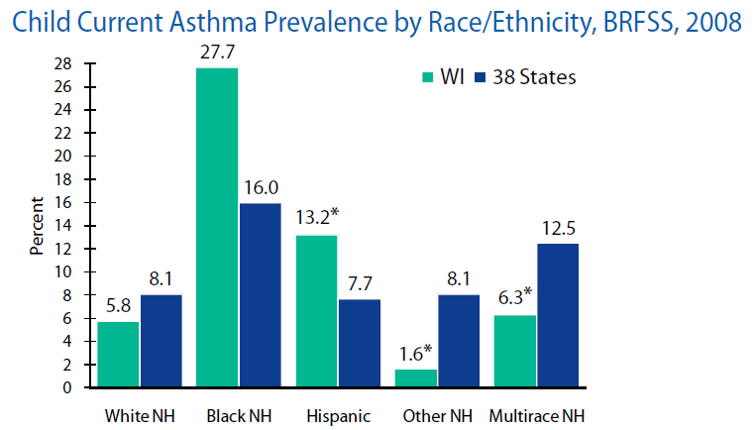
Asthma Statistics
Prevalence: 6.8 million children in US (2012)
9.3 % of population US children
In WI, 98,881 children (2008)
7.5 % of population WI children
Non-Hispanic black children highest rates
Notes:
In the United States, approximately 7 million children or 9 % of US children have asthma.
Low-income populations, minorities, and children living in inner cities experience more ED visits, hospitalizations, and deaths due to asthma than the general population.
In Wisconsin in 2008, almost 100,000 children had asthma. Non-hispanic black children had the highest rates and is almost double that of the national prevalence.

Slide 4
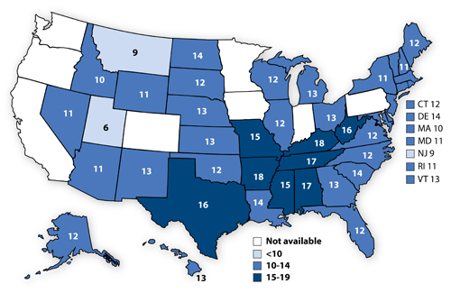
Obesity Statistics
Obesity defined as BMI-for-age > 95 %ile
Prevalence: 17 % of US children (2003 – 2004)
~ 20 % live below 130 % of the federal poverty level
26 - 30 % of children with asthma are obese
Notes:
Obesity is defined as > 95 %ile for BMI-for-age on the CDC growth charts. In the US, 17 % of children fall into this category. And 20 % of those lived beneath 130 % of the FPL.
Interesting to note that for whites, there is a decrease in rates of obesity for increasing income, not so of other ethnic groups.
26 % in study of 10,600 children. 30 % of kids with asthma are obese according to study of ~500 kids in Texas. Most agree the rates of obesity among children with asthma is higher than the non-asthma population.
MAP = Percentage of High Schoolers that are obese according to the 2013 Youth Risk Behavior Survey

Slide 5
Obesity & Asthma
Chicken and the egg
Obese children have more respiratory symptoms than their normal weight peers
more likely to exhibit moderate airflow obstruction defined as an FEV₁/FVC < 0.80
Respiratory related pathology increases with increasing weight
Comorbid conditions: Obstructive Sleep Apnea, Gastroesophageal Reflux
Notes:
Much of the research is about risk of asthma in obese populations.
Comorbid conditions associated with both obesity and asthma such as OSA and GERD, can be additionally worrisome.

Slide 6
What did I do?
Literature Review
Reached out to RDs at other PPCs
Met with Pulmonologists and NPs at both Pulmonary Clinic and Allergy/Asthma Clinics
Met with Nutrition Education Committee on messaging
Attended Pediatric Obesity Symposium
Rabbit Holes

Slide 7
Expert Committee Recommendations Prevention, Assessment, & Treatment of Child & Adolescent Overweight/Obesity
Screening for obesity should be done at PCP level
Staged approach to intervention
Stage 1: Prevention Plus
Stage 2: Structured weight management
Stage 3: Comprehensive Multi-disciplinary Intervention
Stage 4: Tertiary Care intervention
Depends on the patient/family readiness for change
Notes:
Stage 1: Prevention Plus at PCP office
Stage 2: Structured weight management at PCP office with support
Stage 3: Comprehensive Multi-disciplinary Intervention at Peds wt mgmt center
Stage 4: Tertiary Care intervention

Slide 8
Expert Panel Report 3: Guidelines for Diagnosis and Management of Asthma
Control of environmental factors and comorbid conditions that affect asthma
Identify and treat comorbid conditions that may impede asthma management
Overweight
Obesity

Slide 9
RDs at Other PPCs
Florida – only see those with OSA in Sleep Clinic; seen every 6 months
Arizona – no asthma patients seen; only CF
Washington – seen by peds RD (not PPC) or referred to weight management program

Slide 10
What can subspecialists do?
Obesity-related problems particular to subspecialty
Helpful to link obesity with medical diagnosis
Many “fall through the cracks”
Comprehensive approach and consistent messaging
May help motivate patients & families
Diet-induced weight loss can result in improved clinical outcomes
Notes:
Pediatric subspecialists have an important role to play in the treatment of obesity-related comorbidities. Subspecialists have opportunities to engage in obesity prevention and
intervention based on their knowledge of the obesity-related problems particular to their subspecialty.
For example, a patient presenting with asthma at a BMI > 95th would benefit greatly from not only hearing a discussion of the relationship of obesity and asthma control
and the recommendation to “lose weight,” but also a discussion of how they might achieve the necessary lifestyle changes.
Many patients move through subspecialty care without their elevated BMI being addressed, and an opportunity is missed to provide information and evaluation of the health risk their obesity presents. It is also a missed opportunity for improved outcomes.
Diet-induced weight loss can result in improved clinical outcomes (asthma control, BMI z-score, CRP) according to a small sample 2013 RCT.

Slide 11
Recommendations
Discuss with patient and family
Messaging included in After Visit Summary
Weight class documented in narrative note
Communicated to PCP in letter
Weight class documented in problem list

Slide 12
Recommendations
Patient and Family
Discuss
Peds Specialty Clinics
Problem List
Note
Primary Care Provider
Letter
AVS

Slide 13
Who is this for?
Asthma diagnosis
Overweight BMI 85 – 95 %ile
Obese BMI > 95 %ile
Seen in Pediatric Specialty Clinics

Slide 14
Discussion with Patient & Family
Make the link between asthma control and a healthy diet and physical activity
Proposed: (Thanks, Amy Caulum!)
Children come in all shapes and sizes, however, being at a healthy weight for height, eating right and being active can improve asthma control.
How do you feel about making some changes to help your child eat healthy or be more active?
[if they live locally] Can I provide you local resources today that can help with this?
Notes:
Ask families if their PCP has discussed this with them.
This is a part of the medical treatment for asthma.

Slide 15
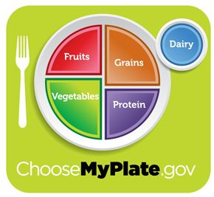
Local Intervention Options
Pediatric Fitness Clinic (ages 5-18)
Registered Dietitian
UW Health: General template or East/West Clinics
YMCA programs
MyPlate
Notes:
At a minimum, the MyPlate website is a resource for families who are just beginning contemplate lifestyle changes.

Slide 16
After Visit Summary
After Visit Care Plan Nutrition Recommendations
A healthy weight is important for a child's well-being. UW Health registered dietitians are able and willing to assist you and your child achieve better health through family-focused nutrition education.
If are interested in making an appointment, call:
UW Health East Clinic or UW Health West Clinic: (608) 890-5500.
Research Park Pediatric Fitness Clinic: (608) 890-8562.
All other UW Health clinics: (608) 287-2770.
You can also visit our website at www.uwhealth.org/nutrition.
Insurance coverage for these visits can vary. Please check with your child’s primary doctor and your insurance company before making an appointment.

Slide 17
Letter to PCP
[Name] has been identified as [overweight/obese] based on [BMI percentiles]. Overweight/obesity negatively affects asthma control and risk of chronic disease later in life. Overweight/Obesity has been added to the patient’s problem list. This patient would benefit from participation in healthy lifestyle intervention. Pediatric Fitness Clinic, the YMCA, and registered dietitians through UW Health are some common options.

Slide 18
Future Directions
Research study on the effect of coordinated care for obesity treatment in asthma population
Roll out to the rest of Pediatric Specialty Clinics

Slide 19
Conclusion
Obese children have more respiratory symptoms than their normal weight peers
Addressing obesity improves outcomes
Subspecialties in an unique position
Help link obesity and asthma control for families
Notes:
The treatment of asthma includes addressing comorbidities. Obesity in children with asthma leads to more respiratory symptoms than normal weight peers. Addressing obesity improves outcomes.
Subspecialties are in a unique position to provide comprehensive asthma care. This helps link weight management to asthma control and provides a consistent message to the patient and families about obesity and health.

Slide 20
References
Barlow, S. E. (2007). Expert committee recommendations regarding the prevention, assessment, and treatment of child and adolescent overweight and obesity: summary report. Pediatrics, S164-S192.
Centers for Disease Control and Prevention. (2011, November). Asthma in Wisconsin. Retrieved from CDC's National Asthma Control Program: http://www.cdc.gov/asthma/stateprofiles/asthma_in_wi.pdf
Centers for Disease Control and Prevention. (2013). Obese youth over time: Perentage of high school student who were obese. Retrieved March 2014, from http://www.cdc.gov/healthyyouth/obesity/obesity-youth.htm
Deane, S., & Thomson, A. (2006). Obesity and the pulmonologist. Archives of Disease in Childhood, 188-191.
Hassink, S. (2009). Weighing risk: the expert committee's recomendations in practice. Seminars in Pediatric Surgery, 159-167.
Jensen, M., Gibson, P., Collins, C., Hilton, J., & Wood, L. (2013). Diet-induced weight loss in obese children with asthma: a randomized controlled trial. Clinical & Experimental Allergy, 775-784.
Lang, J., Hossain, J., Smith, K., & Lima, J. (2012). Asthma severity, exacerbation risk, and controller treatment burden in underweight and obese children. Journal of Asthma, 456-463.
National Asthma Education and Prevention Program. (2007). Expert panel report 3 (EPR-3): guidelines for the diagnosis and management of asthma-summary report 2007. Journal of Allergy and Clinical Immunology, S94-S138.
Peters, J., McKinney, J., Smith, B., Wood, P., Forkner, E., & Galbreath, A. (2011). Impact of obesity in asthma: evidence from a large prospective disease management study. Annals of Allergy, Asthma & Immunology, 30-35.

Slide 21

Questions

