Slide 1
Safety and Injury Prevention for Children with Special Needs
Linn Duga RN, CPNP
PPC Capstone
January 10, 2012

Slide 2
Goals
Explore unintended injury in the pediatric population and in CYSHCN
Identify injury patterns and trends in children
Focus on safety issues for the child with special health care needs
Propose safety education strategies for CYSHCN

Slide 3

History and Background

Slide 4
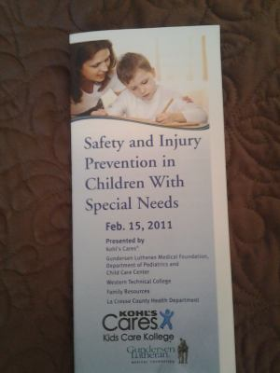
Kohl’s Cares for Kids

Slide 5
Children with Special health care needs
“...those who have or are at increased risk for a chronic physical, developmental, behavioral, or emotional condition and who also require health and related services of a type or amount beyond that required by children generally.”
McPherson M, Arango P, Fox H, Lauver C, McManus M, Newacheck P, Perrin J, Shonkoff J, Strickland B. A new definition of children with special health care needs. Pediatrics, 102(1):137–140, 1998.

Slide 6
Audience
  Families
  Caregivers
  Day care providers
Prevention strategies based on level of functioning and challenges faced by the individual child

Slide 7


Slide 8
Accidents vs.
Unintentional Injuries
Accidents imply events or injuries are
due to random or chance occurrences that cannot be prevented
Unintentional injuries are predictable and preventable if safety measures are implemented
(Pless, I.B., and Hagel, B.E. 2005)

Slide 9
"Injury is probably the most under recognized major public health problem facing the nation today.”
— National Academy of Sciences, 1988

Slide 10
“If a disease was killing our children
in the proportions that accidents
(injuries) are, people would
be outraged and demand that this
killer be stopped.”
Koop, C. Everett. "Statement before the Subcommittee on Children, Family, Drugs, and Alcoholism, U.S. Senate" 2003.

Slide 11
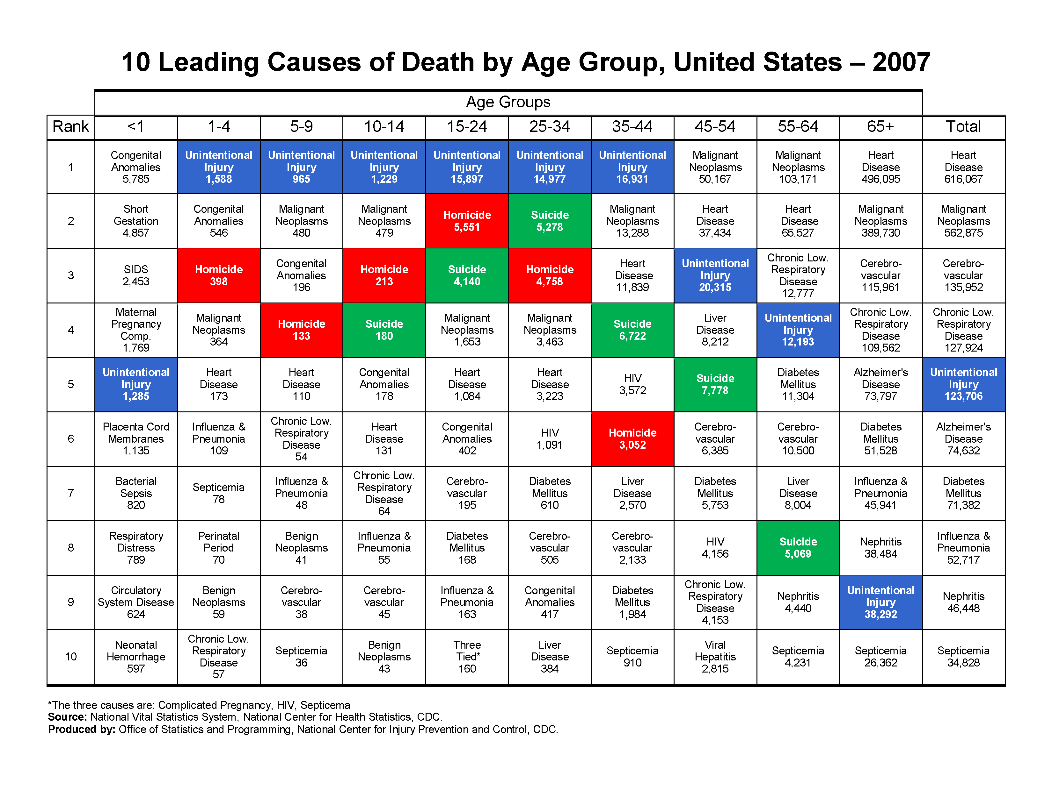

Slide 12
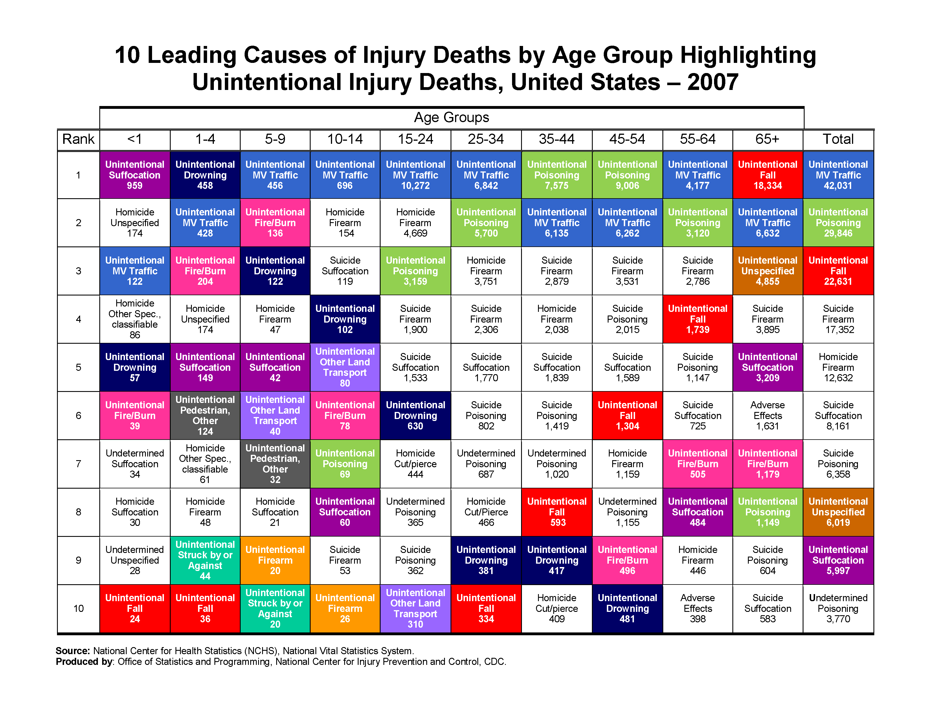

Slide 13
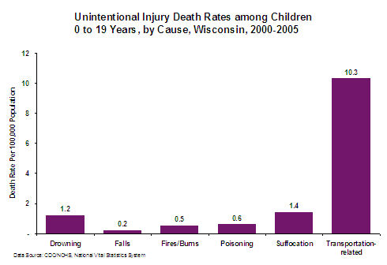
www.cdc.gov/safechild/states/wi.html

Slide 14
CDC Childhood Injury Report
Leading cause of death for children 0-19 years of age
Males>Females
Motor vehicle related injuries #1 cause of death
Causes of injury death differ by age
  < 1 year
  1-4 years
  5-19 years
www.cdc.gov/safechild/Child_Injury_Data.html

Slide 15
CDC Childhood Injury Report: Nonfatal Injuries
9.2 million annual visits to ER’s
Males>Females
Leading cause of injury : Falls 2.8 million
Most nonfatal injuries from:
  Falls (children < 15 years of age)
  Stuck , animal bites, insect stings (0-9 years)
  Struck by/against an object and overexertion (10-14 years)
  Struck by/against an object, falls MVA’s (15-19 years)
www.cdc.gov/safechild/Child_Injury_Data.html

Slide 16
Trends in the prevalence of developmental disabilities in US Children, 1997-2008
(BOYLE, c.a., Boulet, S., Schieve, L.A., Cohen, R.A. et al. Pediatrics 2008)
Data is limited
National Health Interview Surveys (NHIS)
In children aged 3-17 years the prevalence of developmental disabilities increased 2.2% to 15.04%
1 in 6 children

Slide 17
Diagnosis to function: classification for children and youths
(Lollar, D.J., and Simeonsson, R.J., 2005)
Most chronic conditions of CYSHCN are not fatal
Associated with compromised functional status
Assessment of function is key to reducing limitations and well being
Universal framework

Slide 18
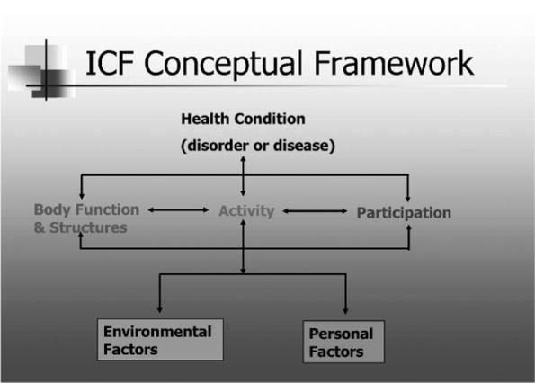
FIGURE 1 . Conceptual framework for International Classification of Functioning, Disability, and Health (ICF).
Diagnosis to Function: Classification for Children and Youths.
LOLLAR, DONALD; SIMEONSSON, RUNE
Journal of Developmental & Behavioral Pediatrics. 26(4):323-330, August 2005.
© 2005 Lippincott Williams & Wilkins, Inc. Published by Lippincott Williams & Wilkins, Inc.
2

Slide 19
Increased Risk of injury in children with Developmental Disabilities
(Lee, L.C, Harrington, R.A. Chang, J.j., connors, S.l.)
Children ages 3-5 years
Diagnoses included: autism, ADD/ADHD, LD, psychopathology, other medical conditions
Children with developmental disabilities were 2-3 times more likely to sustain injuries requiring medical intervention
Additional injury prevention education
Provider awareness
Future research
  Extent to which injuries are related to:
    Core symptoms/co-morbid conditions
    Behaviors
    Inadequate supervision

Slide 20
Injuries Among us children with different types of disabilities
(sinclair, s.a., xiang, h., 2008)
Epidemiology of injury poorly studied
1997-2005 NHIS data
Children with disabilities have higher risk for and prevalence of injuries
No corelation between type of disability and injury rates except in children with emotional or behavioral problems
Continued study needed to support hypothesized corelations

Slide 21
How Mothers parent their children with behavior disorders: implications for unintentional injury risk
(Schwebel, D.c., hodgens, j.b., and sterling, s.)
Mechanisms leading to increased injury risk
  ADHD traits in children
  ODD traits
  Poor parental supervision

Slide 22
For CYSHCN
Safety Issues

Slide 23
Neurobehavioral Disorders
Mobility Impairments
Sensory Related Impairments
Cognitive Disabilities

Slide 24
Neurobehavioral disorders
More frequently injured
Level of activity
Impulsivity
Poor judgment
Common dangers
Wandering
Drowning
Pica
Household toxins
Use visual reminders
Clear/specific rules
Role Play
Provide Supervision

Slide 25
Social stories
Educate family, friends,
neighbors, caregivers,
community health and
rescue providers
Childproof
Teach Personal Safety
Social Stories
Visuals
Fences, Locks
Tracking Devices
Service Animals
Use visual reminders
Clear/specific rules
Role Play
Provide Supervision

Slide 26
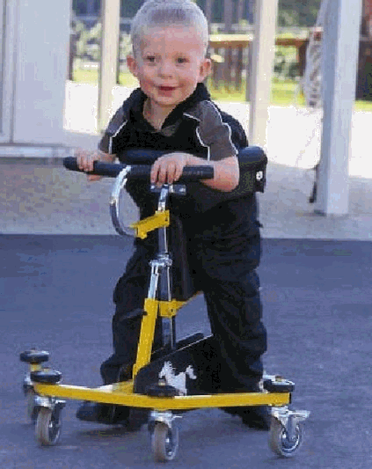
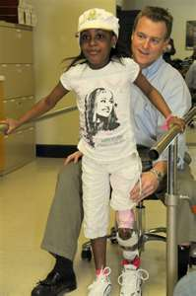
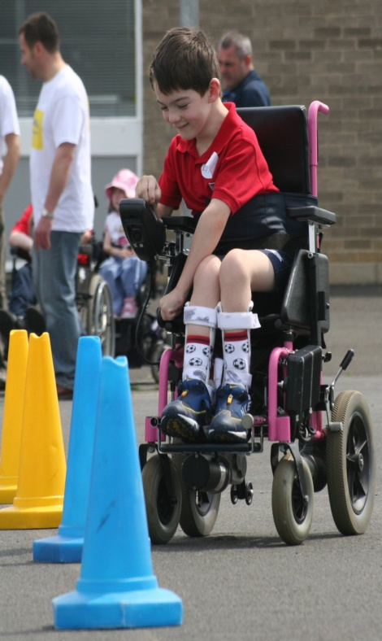
Mobility or Movement Issues

Slide 27
Adaptive equipment
Access
Hazards
Non-slip surfaces
Supervised in water
Safe transport
Transfer techniques
Adequate lighting

Slide 28
Impaired sensation
Skin integrity
Ambient temperature
Cognitive level
Sunscreen
Repositioning
Properly fitting clothing and footwear

Slide 29
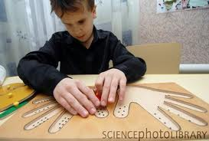


Sensory Related Impairments
Environmental hazards
Contrasting colors
Smoke and fire alarms
Street and automobile
Road safety signs
Use of gestures
Practice!

Slide 30
Cognitive impairments
Level of cognitive function
Motor function
Supervision

Slide 31
Personal Safety
Bullying
Physical violence
Sexual assault
Neglect

Slide 32
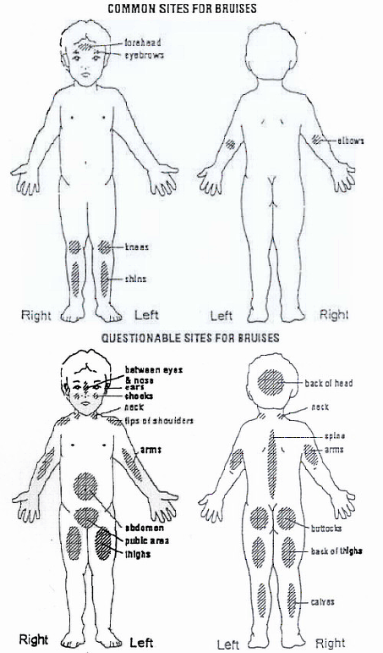

Slide 33
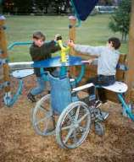

School Safety
Obstacles
Environmental conditions
Accessibility

Slide 34
Playground Safety
Supervision
Review rules
Safe equipment
Dry equipment
Check temperature
Use as intended
Avoid drawstrings
Careful jumping
Supervision
Intervene
Age appropriate
Transition

Slide 35
In summary
Increased risk of injury
Little to no data regarding mechanism of injury
Speculation as to influencing factors
Further study is needed

Slide 36
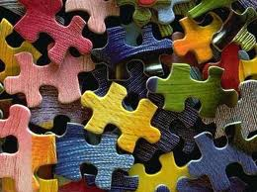
Putting it all together

Slide 37
tools models Theories
Bright Futures
Anticipatory guidance
  Initiated in 1990 HRSB and MCHB
  Theory based
  Health promotion needs
  Tailor safety teaching to the needs of the child

Slide 38
Haddon Matrix
Framework developed in 1968 applying epidemiology principles to motor vehicle collisions
 | Host | Agent | Environment
Pre-event
Event
Post-event

Slide 39
Life Course
Study of the life and health impact of generational, fetal, childhood, adolescence and young adulthood across the life span
protective factors
Risk factors
Multiple outcomes from single interventions
Proximal and distal effects
A Life Course Approach Resource Guide Developed by the MCH Training Program www.mchb.hrsa.gov/lifecourseapproach .html

Slide 40
A life course approach to injury prevention: a “lens and telescope” conceptual model
(Hoskling, j., ameratunga, s., morton, s. and blank, d. 2011)
Use of the Life Course Model for strategies to reduce injury
Core injury concepts and Life Course principles to develop a model for understanding injury risk

Slide 41
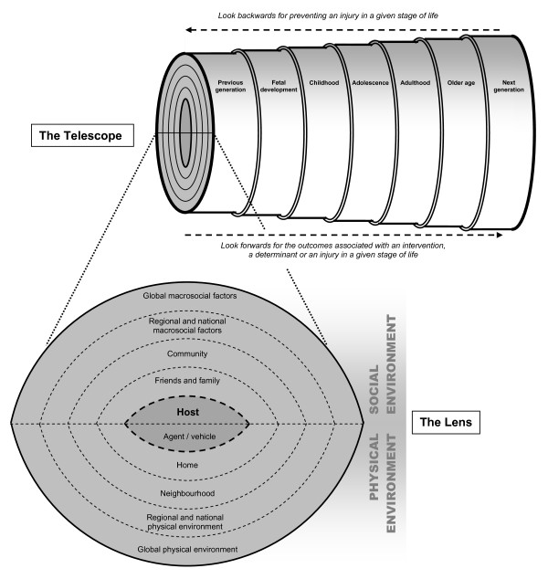
Ecological model of injury across the life course: the "lens and telescope".
Copyright ©2011 Hosking et al; licensee BioMed Central Ltd.
A life course approach to injury prevention: a "lens and telescope" conceptual model
Jamie Hosking,^{#1} Shanthi Ameratunga, ¹ Susan Morton,² and Danilo Blank³
BMC Public Health. 2011; 11: 695. Published online 2011 September 8. doi: 10.1186/1471-2458-11-695 | PMCID: PMC3177801

Slide 42
Developmental Focus
Cognitive functioning
Physical functioning
Prevention strategies based on level of functioning and challenges faced by the individual child

Slide 43


Slide 44
References
Borse NN, Gilchrist J, Dellinger AM, Rudd RA, Ballesteros MF, Sleet DA. CDC Childhood Injury Report: Patterns of Unintentional Injuries among 0 -19 Year Olds in the United States, 2000-2006. Atlanta (GA): Centers for Disease Control and Prevention, National Center for Injury Prevention and Control; 2008.
Pless, I.B., and Hagel, B.E., Injury prevention: a glossary of terms . J Epidemiol Community Health 2005;59: 182-185.

Slide 45
Centers for Disease Control and Prevention Childhood Injury Report. www.cdc.gov/safechild/Child_Injury_Data.html site accessed September 21,2011.
Boyle, C.A., Boulet, S., Schieve, L.A., Cohen, R.A. et al. Trends in the prevalence of developmental disabilities in US children, 1997-2008. Pediatrics 2011; 127; 1034-42.
Lollar, E.J., and Simeonsson, R.J. Diagnosis to function: classification for children and youths. Developmental an Behavioral Pediatrics; 26 (4), August, 2005.

Slide 46
Lee, L.C, Harrington, R.A. Chang, J.J., Connors, S.l. Increased Risk of injury in children with Developmental Disabilities. Res Dev Disabil. 2008 May-Jun; 29(3):247-55.
Sinclair, S.A., Xiang, H. Injuries Among us children with different types of disabilities. American Journal of Public Health. August 2008, 98(8): 1510-16.
Schwebel, D.C., Hodgens, J.B., and Sterling, S. How mothers parent their children with behavior disorders: implications for unintentional injury risk. Journal of Safety Research 37 (2006). 167-173.
Bright Futures http://brightfutures.aap.org/. Site accessed 11/8/11.

Slide 47
National Center for Health Statistics, National Health Interview Survey. About the National Health Interview Survey [article online], 2009. Available at: www.cdc.gov/nchs/nhis/about_nhis.htm#sample_design Accessed September 21, 2011
Haddon Matrix www.ems.gov. Accessed January 9, 2012.
Hoskling, J., Ameratunga, S., Morton, S. and Blank, D. A life course approach to injury prevention: a “lens and telescope” conceptual model. BMC Public Health 2011, 11:695.

Slide 48
Resources
American Academy of Pediatrics www.aap.org
Autism Speaks: Creating Safety Plans for Individuals with Autism www.autismspeaks.org/family-services/autism-safety-project/community/creating-safety-plans
Safe Kids USA www.safekids.org
Centers for Disease Control and Prevention www.cdc.gov/safechild
CDC Injury Prevention and Control: Data and Statistics
www.cdc.gov/injury/wisqars/LeadingCauses.html

Slide 49
Adapting Motor Vehicles for People with Disabilities, U S Department of Transportation. 1-888-DASH-2-DOT
www.nhtsa.dot.gov/cars/rules/adaptive/brochure/brochure.html
Transporting Children with Special Health Care Needs (RE 9852), American Academy of Pediatrics, www.aap.org/policy/re9852

Slide 50
www.Kidpower.org

