Slide 1
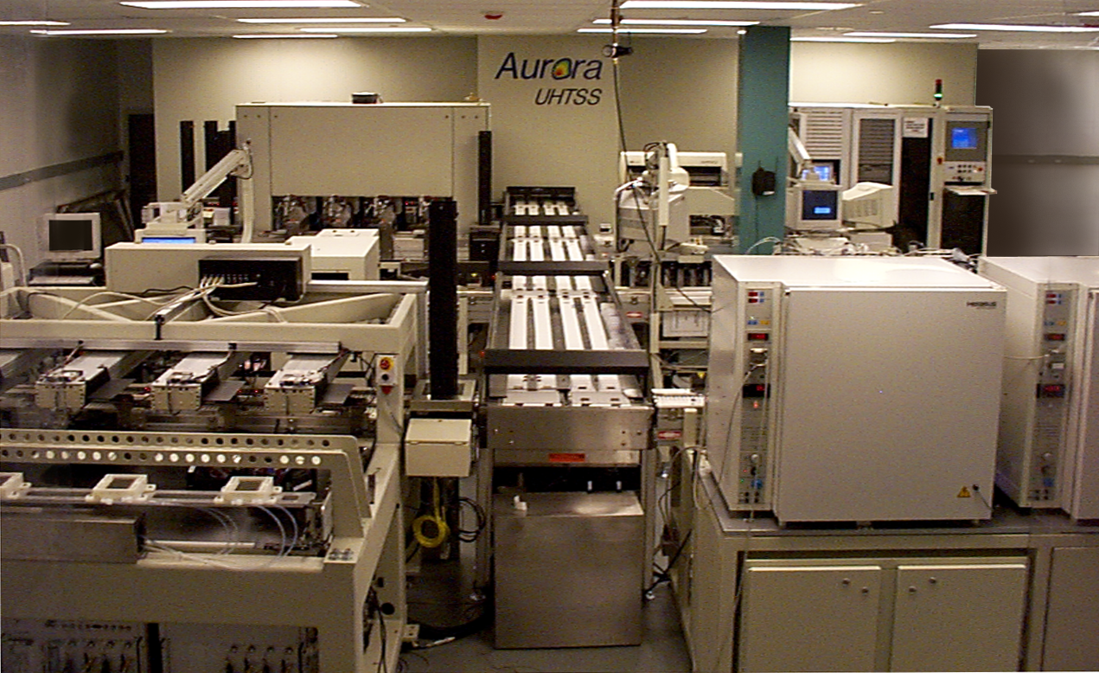
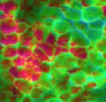

High-Throughput Screening Speeding Up CF Drug Discovery
High-throughput screening
Screening Assay
Prioritize hits
>10,000 Primary assays/day
SAR based Medicinal Chemistry
Courtesy of Vertex Pharmaceuticals
CFTR Modulator Drug

Slide 2
VX-770 Phase III Study Design
Randomization
(1:1)
Primary analysis
VX-770
150 mg q12h
VX-770
150 mg q12h
Open-label rollover study
Screening
Run-in
VX-770 150 mg q12h
Placebo
Placebo
Or
2-yr Follow-up
Day -35
-14
0
Week 24
48
Treatment period
Extension period
Randomized, double-blind, placebo-controlled
Recruitment: 161 subjects
Key inclusion criteria
G551D mutation on at least one CFTR allele
Aged ≥ 12 years
FEV₁ 40% to 90% predicted
Elborn JS, 34th ECFC 2011
http://clinicaltrials.gov (NCT00909532)

Slide 3
Change from Baseline in Sweat Chloride
Treatment effect through Week 24
– 47.9 mmol/L
P < 0.0001
Treatment effect through Week 48
– 48.1 mmol/L
P < 0.0001
Elborn JS, 34th ECFC 2011
Vertex press release June 10, 2011

Slide 4
Absolute Change in FEV₁ % Predicted
Treatment effect through Week 24
+ 10.6 %
P < 0.0001
Treatment effect through Week 48
+ 10.5 %
P < 0.0001
Elborn JS, 34th ECFC 2011
Vertex press release June 10, 2011

Slide 5
Time to First Pulmonary Exacerbation
Modified Fuchs’ criteria
Week 24
Hazard Ratio
0.40
P = 0.0016
Week 48
Hazard Ratio
0.46
P = 0.0012
1.0
0.9
0.8
0.78
0.7
Placebo
VX-770
0.67
0.6
Proportion of event-free subjects
0.5
0.51
0.4
0.41
0.3
0.2
PLACEBO
PLACEBO
VX-770
0.1
VX-770
Event-Free Rate At Week 48
Event-Free Rate At Week 48
0.41
0.67
Hazard Ratio: 0.45 ( 0.28, 0.73) P=0.0012
0.0
0
28
56
84
112
140
168
196
224
252
280
308
336
364
Study day
Elborn JS, 34th ECFC 2011
Vertex press release June 10, 2011

Slide 6
Change from Baseline in CFQ-R Respiratory Domain
Treatment effect through Week 24
+ 8.1
P < 0.0001
Treatment effect through Week 48
+ 8.6
P < 0.0001
MCID = 4*
* MCID, minimal clinically important difference (Quittner et al 2009)
Elborn JS, 34th ECFC 2011;Vertex press release June 10, 2011

Slide 7
Change from Baseline in Weight
Treatment effect at Week 24
+ 2.8 kg
P < 0.0001
Treatment effect at Week 48
+ 2.7 kg
P = 0.0001
Elborn JS, 34th ECFC 2011
Vertex press release June 10, 2011
See talk by M Drumm: S1 (Thursday 2:00 PM)

Slide 8
Summary of VX-770 Phase III Study in CF Patients with the G551D Mutation
Rapid onset and sustained improvement in lung function (primary endpoint: absolute change in % predicted FEV₁)
Parallel improvement in CFTR function and lung function
Sustained improvements in other outcomes including risk of exacerbation, respiratory symptoms and weight gain
No important safety concerns
KALYDECO was approved by the FDA on January 31, 2012 for patients with CF who are 6 years of age and older and who have a G551D mutation
For more information on other VX-770 studies, see posters
by R Ahrens, E McKone & P Flume: #s 203, 204 & 206, respectively

Slide 9
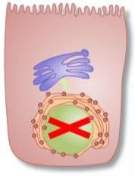
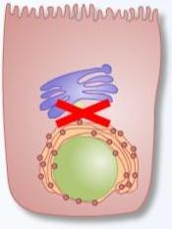
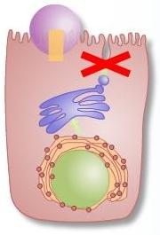
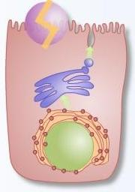
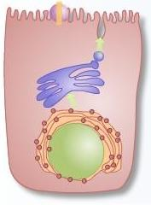
5 Classes of CFTR Mutations
II
Defective
Processing
I
Defective
Production
III
Defective
Regulation
IV
Defective
Conductance
V
Reduced
Amounts
CFTR is made
& in proper
Location, but
Does not function
normally
G542X
R553X
W1282X
F508del
G551D
N1303K
R117H
R334W
3849+10kbC>T
3272-26A>G

Slide 10
2011 Clinical Studies with CFTR Modulators
CFTR potentiator VX-770:
Phase III study in CF patients with the G551D CFTR mutation
CFTR corrector VX-809:
Phase IIa study in CF patients with the ΔF508 CFTR mutation
Rowe SM et al., New Engl J Med 2005

