Slide 1
Pulmonary Exacerbation Nuts and Bolts
D.B. Sanders, MD
UW-Madison Parent Webinar

Slide 2
Definition/Epidemiology
An acute worsening of signs and symptoms
Cough, increased sputum, decreased energy, decreased appetite, weight loss
Can include coughing up blood, shortness of breath, chest pain
Usually accompanied by an acute decrease in lung function (usually, FEV₁)
35-40% of patients with CF require IV antibiotics each year
Many more require oral or inhaled antibiotics

Slide 3
What causes a pulmonary exacerbation?
Anything that disrupts the bacteria that can be found in the lungs of people with CF:
New bacteria (Pseudomonas aeruginosa)
Old bacteria, new growth, or new virulence
Viral infections (influenza)
Not taking medications regularly
Other: pollution, allergies, reflux (heartburn), ABPA

Slide 4
Why are exacerbations important?
You don’t feel good
Missed work, missed school, missed activities
May require hospitalization
May lead to more decline in lung function
~25% of patients don’t immediately recover all of their lung function after they are hospitalized for an exacerbation

Slide 5
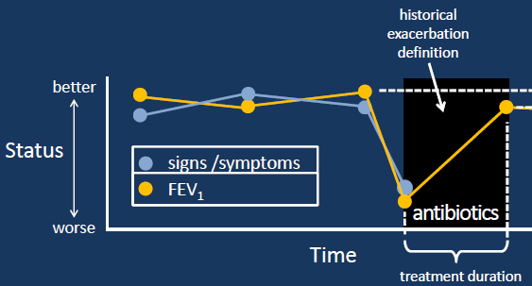
Why are exacerbations important?

Slide 6
What to do?
If you are having symptoms of an exacerbation:
Increase chest PT to 3-4 times per day
Make sure you are taking all of your medications
Call us if symptoms are really bad, or if they’re not getting better after 4-5 days

Slide 7
What are our options?
We may prescribe oral or inhaled antibiotics over the phone
We may ask you to come to clinic for a visit
We may decide to admit you to the hospital
In the hospital:
We use IV antibiotics (usually 2)
We give chest PT 4 times per day
We make sure to increase nutrition
We try to make sure you get rest

Slide 8
How can you prevent an exacerbation?
Take your medications and do your chest PT
Maintain your weight
Get the flu vaccine every year
Avoid people with colds/wash your hands
Let us know early

